Slide 1
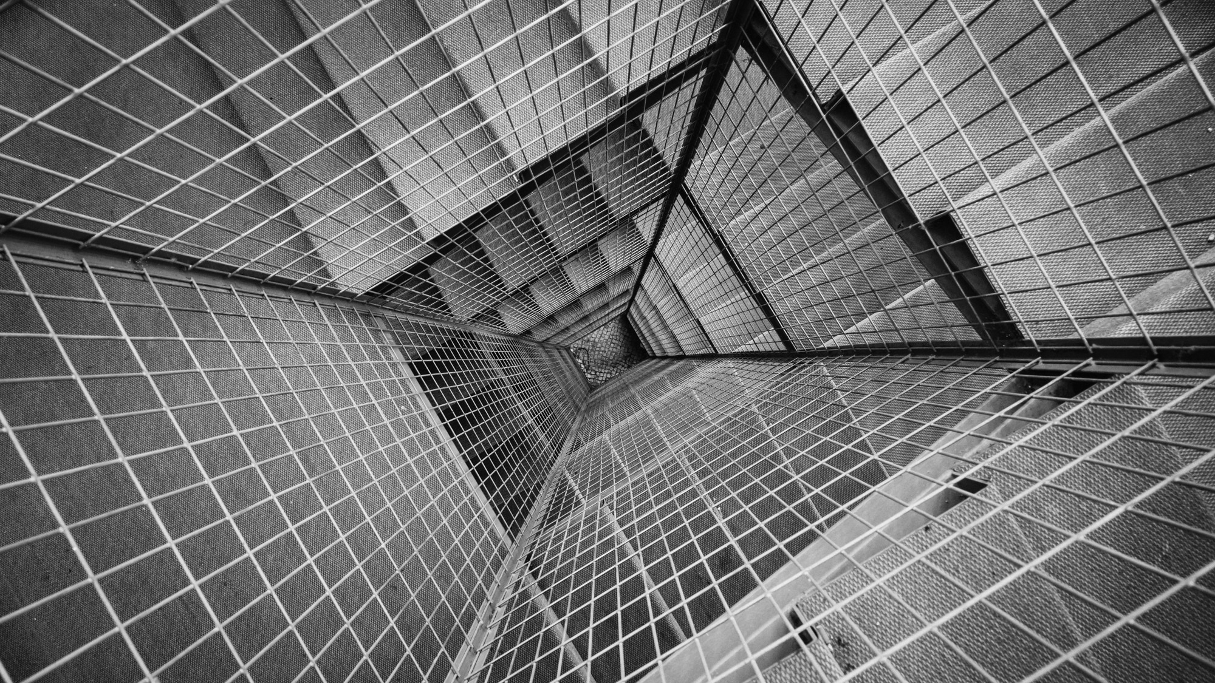
TOTAL TECHNOLOGY
REPORTLAB COMPLETE TUTORIAL
How to GENERATE QR code in pdf file
Tutorial 41

Slide 2
HOW TO GENEATE QR CODE IN PDF FILE:
from reportlab.graphics.barcode import qr
from reportlab.pdfgen import canvas
from reportlab.graphics import shapes,renderPDF
pdf=canvas.Canvas("tutorial41.pdf")
text="www.totaltechnologyabcd.com"
qrcode=qr.QrCodeWidget(text)
drawing_obj=shapes.Drawing()
drawing_obj.add(qrcode)
renderPDF.draw(drawing_obj,pdf,200,200)
pdf.save()
TOTAL TECHNOLOGY

Slide 3
HOW TO GENEATE QR CODE AND EXPORT AS PNG:
from reportlab.graphics.barcode import qr
from reportlab.graphics import shapes,renderPM
drawing_obj=shapes.Drawing(500,500)
code="www.totaltechnoogy.com"
qrcode=qr.QrCodeWidget(code)
qrcode.barWidth=200
drawing_obj.add(qrcode)
renderPM.drawToFile(drawing_obj, fn="roni.png" )
TOTAL TECHNOLOGY

Slide 4
HOW TO GENEATE QR CODE USING PYTHON QRCODE PACKAGE (https://pypi.org/project/qrcode/)
Using platypus flowable
import qrcode
from reportlab.platypus import SimpleDocTemplate,Image
from reportlab.lib.styles import getSampleStyleSheet
pdf=SimpleDocTemplate("tutorial41_1.pdf")
flow_obj=[]
code="www.totaltechnoogy123456.com"
qrcode=qrcode.make(code)
qrcode.save("roni1.png")
image=Image("roni.png")
flow_obj.append(image)
pdf.build(flow_obj
TOTAL TECHNOLOGY

Slide 5
HOW TO GENEATE QR CODE USING PYTHON QRCODE PACKAGE (https://pypi.org/project/qrcode/)
Using canvas
import qrcode
from reportlab.platypus import SimpleDocTemplate,Image
from reportlab.lib.styles import getSampleStyleSheet
from reportlab.pdfgen import canvas
from reportlab.lib.units import cm
pdf=canvas.Canvas("tutorial41_1.pdf")
pdf.translate(cm,cm)
flow_obj=[]
code="www.totaltechnoogy123456.com"
qrcode=qrcode.make(code)
qrcode.save("roni1.png")
pdf.drawImage("roni.png",10,50,800,800)
pdf.save()
TOTAL TECHNOLOGY

